Slide 1
Basic Electrical & Electronics Engineering
Unit 5
(OPERATIONAL AMPLIFIERS & Electronic Instrumentation )

Slide 2
OPERATIONAL AMPLIFIERS
Introduction, Op-Amp Basic, Practical Op-Amp Circuits (Inverting Amplifier, Noninverting Amplifier, Summing Amplifier, Integrator, Differentiator).
Electronic Instrumentation
Digital Multimeter (DMM), Types of sensor, Introduction to IoT and its application.

Slide 3
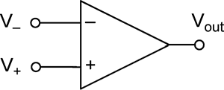
Introduction of operational amplifier:
Operational amplifiers are linear devices that have all the properties required for nearly ideal DC amplification
Used in signal conditioning, filtering or to perform mathematical operations such as add, subtract, integration and differentiation.
It is a voltage amplifying device.
Three-terminal device which consists of two high impedance inputs, one called the Inverting Input, marked with a negative or “minus” sign, (-) and the other one called the Non-inverting Input, marked with a positive or “plus” sign (+).

Slide 4
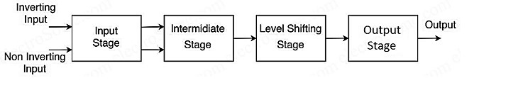
Block diagram of operational amplifier:
Input stage: The i/p stage is a dual i/p, balanced o/p differential amp. The 2 i/p are inverting and non- inverting i/p terminals. This stage provides most of the voltage gain of the OP-AMP and decides the value of i/p resistance Ri.
Intermediate stage: This is usually another differential amp. The i/p stage drives the stage. The stage is a dual –i/p unbalanced o/p differentiated amp.
Level- shifting stage: Due to direct coupling used between the 1st 2 stages, the i/p of level shifting stage is an amplified signal with some non – zero dc level. Level shifting stage is used to bring dc level to zero volts with respect to gnd.
Output stage: This stage is normally a complementary o/p stage. It increases the magnitude of voltage and raises the current supplying capability of OP-AMP. It also ensures that the o/p resistance of OPAMP is low.

Slide 5
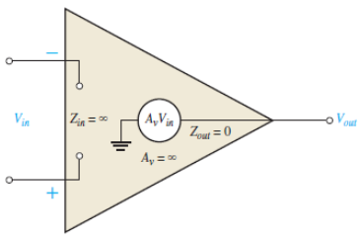
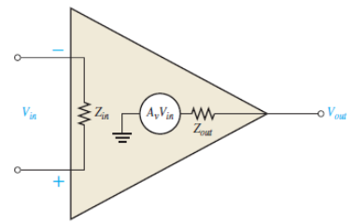
Introduction of operational amplifier:
The Ideal Op-amp: The ideal op-amp has:
infinite voltage gain
infinite input impedance (open)
zero-output impedance.
The Practical Op-amp: The practical op-amp has:
Very high voltage gain
Very high input impedance
Very low output impedance.

Slide 6
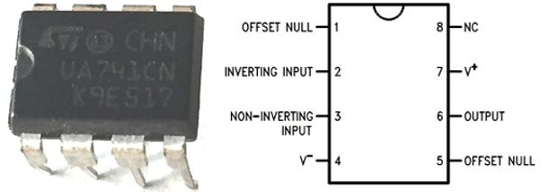
Pin diagram of operational amplifier (LM741):
The mostly used op amp IC is LM741. It is an 8 pin IC. The pin configuration of LM741 is given below.
Applications of LM741 include Comparator, DC Amplifier, Summing Amplifier, Integrator or Differentiators and Active Filters.

Slide 7
Practical op-amp circuits:
Inverting Amplifier,
Noninverting Amplifier,
Summing Amplifier,
Integrator,
Differentiator

Slide 8
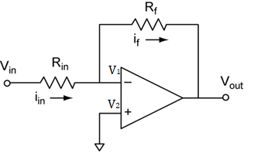
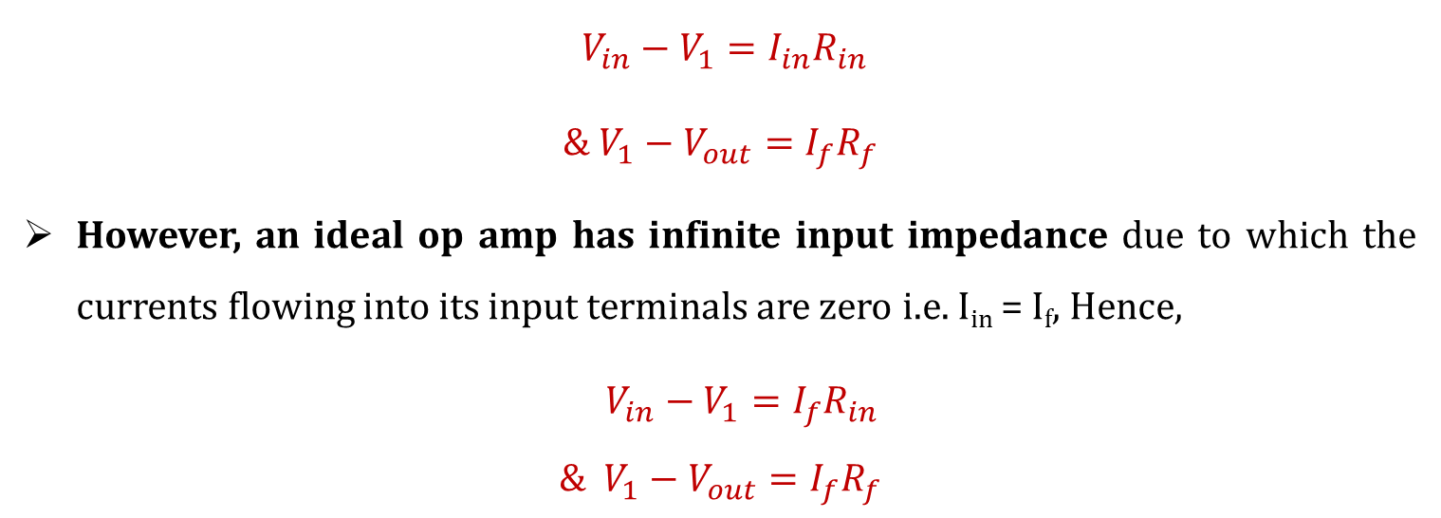
(i) Inverting Amplifier:
It produces an output which is out of phase with respect to its input by 180º
The input signal is applied to the inverting (-) input via resistor R_{in}.
Noninverting terminal is connected to the ground.
Output is applied back to the inverting input through the feedback circuit formed by the input resistor R_{in} and the feedback resistor R_{f}.
$$V_{in}−V_{1}=I_{in}R_{in}$$
$$\& V_{1}−V_{out}=I_{f}R_{f}$$
However, an ideal op amp has infinite input impedance due to which the currents flowing into its input terminals are zero i.e. I_{in} = I_{f}, Hence,
$$V_{in}−V_{1}=I_{f}R_{in}$$
$$\& V_{1}−V_{out}=I_{f}R_{f}$$

Slide 9

(i) Inverting Amplifier:
An ideal op amp the voltage at inverting and non-inverting inputs are always equal. Here, we have grounded the non-inverting terminal, zero voltage appears at the non – inverting terminal.
That means V₂ = 0. Hence, V₁ = 0, also.
$$V_{in}−0=I_{f}R_{in}$$
$$\& 0−V_{out}=I_{f}R_{f}$$
Hence, Voltage gain,
$$A_{v}=\frac{V_{out}}{V_{in}}=−\frac{R_{f}}{R_{in}}$$

Slide 10

(i) Inverting Amplifier:
Q.1: An inverting amplifier has an input voltage of 1 V. The input resistance R1 = 1kΩ and feedback resistance is 5kΩ. Find the output voltage and voltage gain of the amplifier.
Solution: Voltage gain of an inverting amplifier is given by,
$$A_{v}=\frac{V_{out}}{V_{in}}=−\frac{R_{f}}{R_{1}}=−\frac{5×{10}^{3}}{1×{10}^{3}}=−5$$
Now, output voltage,
$$V_{out}=A_{v}V_{in}=−5×1$$
$$V_{out}=−5 V$$

Slide 11
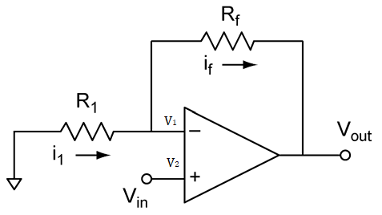

(ii) Non-inverting Amplifier:
It produces a positive voltage gain.
Input signal is applied to the noninverting (+) input
Inverting terminal is connected to the ground through resistor R₁.
Output is applied back to the inverting input through the feedback circuit formed by the input resistor R_{in} and the feedback resistor R_{f}.
$$I_{1}=I_{f}$$
$$−\frac{V_{1}}{R_{1}}=\frac{V_{1}−V_{out}}{R_{f}}$$
Now, if we assume that the op amp in the circuit is ideal op amp, then,
$$V_{1}=V_{2}=V_{in}$$
Therefore,
$$−\frac{V_{in}}{R_{1}}=\frac{V_{in}−V_{out}}{R_{f}}$$

Slide 12
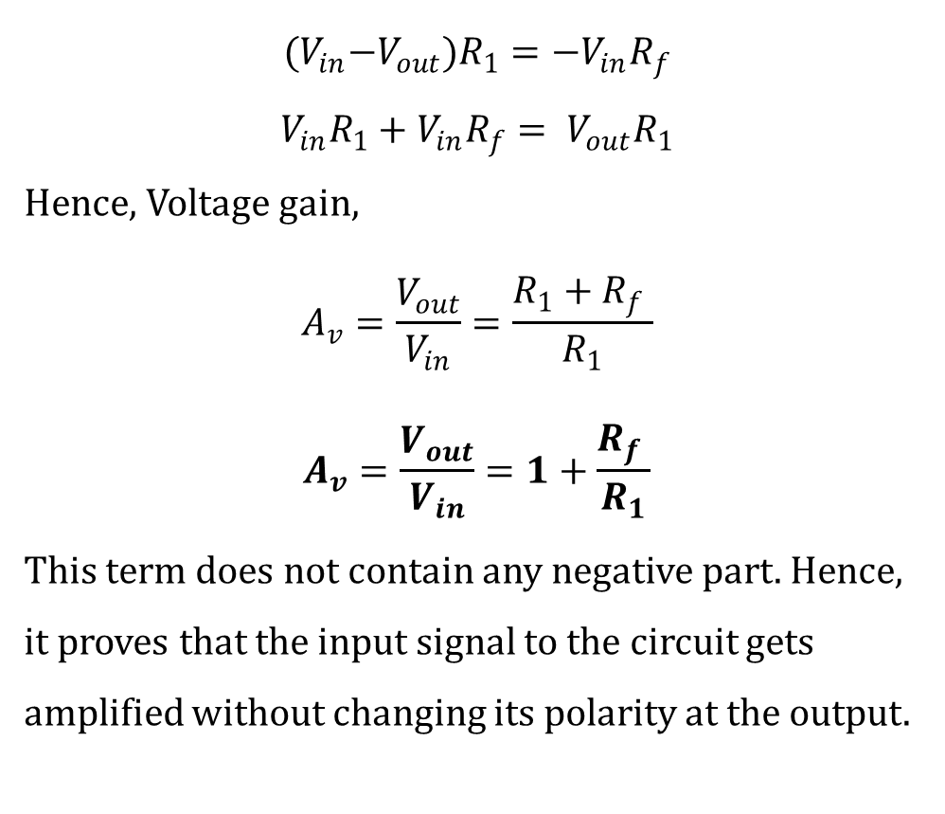
(ii) Non-inverting Amplifier:
$${(V}_{in}−V_{out})R_{1}=−V_{in}R_{f}$$
$$V_{in}R_{1}+V_{in}R_{f}= V_{out}R_{1}$$
Hence, Voltage gain,
$$A_{v}=\frac{V_{out}}{V_{in}}=\frac{R_{1}+R_{f} }{R_{1}}$$
$$A_{v}=\frac{V_{out}}{V_{in}}=1+\frac{R_{f} }{R_{1}}$$
This term does not contain any negative part. Hence, it proves that the input signal to the circuit gets amplified without changing its polarity at the output.

Slide 13

(ii) Non-inverting Amplifier:
Q.2: A non-inverting amplifier has an input voltage of 10 V. The input resistance R1=1kΩ and feedback resistance is 5kΩ. Find the output voltage and voltage gain of the amplifier.
Solution: Voltage gain of a non-inverting amplifier is given by,
$$A_{v}=\frac{V_{out}}{V_{in}}=1+\frac{R_{f} }{R_{1}}=1+\frac{5×{10}^{3}}{1×{10}^{3}}=6$$
Now, output voltage,
$$V_{out}=A_{v}V_{in}=6×10$$
$$V_{out}=60 V$$

Slide 14
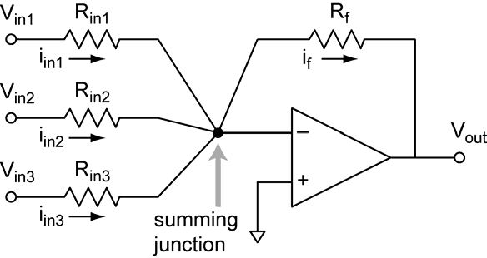
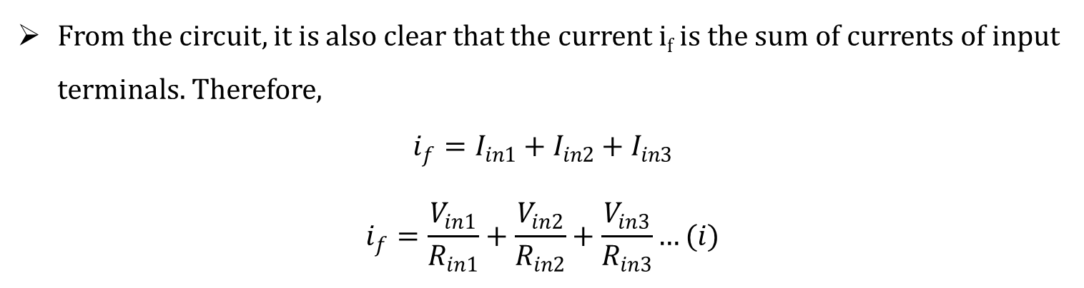
(iii) Summing Amplifier (Adder):
It can combine numbers of input signal to a signal output that is the weighted sum of the applied inputs
n numbers of input terminal are connected in parallel to the inverting terminal.
Non-inverting terminal is grounded, hence potential at that terminal is zero.
As the op amp is considered as ideal op amp, the potential of the inverting terminal is also zero.
From the circuit, it is also clear that the current i_{f} is the sum of currents of input terminals. Therefore,
$$i_{f}=I_{in1}+I_{in2}+I_{in3}$$
$$i_{f}=\frac{V_{in1}}{R_{in1}}+\frac{V_{in2}}{R_{in2}}+\frac{V_{in3}}{R_{in3}}…(i)$$

Slide 15
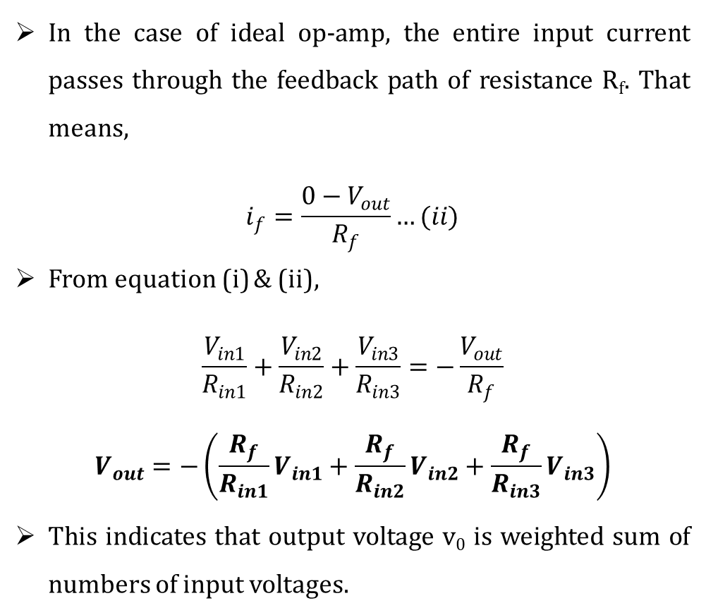
(iii) Summing Amplifier (Adder):
In the case of ideal op-amp, the entire input current passes through the feedback path of resistance R_{f}. That means,
$$i_{f}=\frac{0−V_{out}}{R_{f}}…(ii)$$
From equation (i) & (ii),
$$\frac{V_{in1}}{R_{in1}}+\frac{V_{in2}}{R_{in2}}+\frac{V_{in3}}{R_{in3}}=−\frac{V_{out}}{R_{f}}$$
$$V_{out}=−\left(\frac{R_{f}}{R_{in1}}V_{in1}+\frac{R_{f}}{R_{in2}}V_{in2}+\frac{R_{f}}{R_{in3}}V_{in3}\right)$$
This indicates that output voltage v₀ is weighted sum of numbers of input voltages.

Slide 16
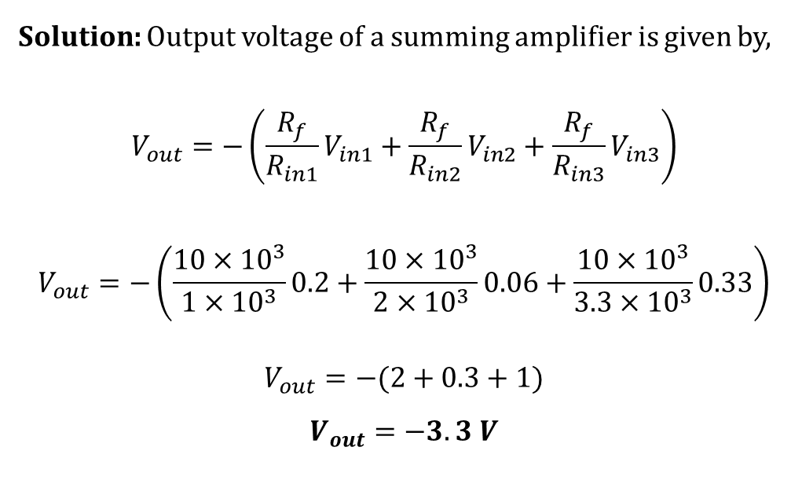
(iii) Summing Amplifier (Adder):
Q.4: For an adder circuit feedback resistance is 10 kΩ. Input arm resistances are 1kΩ, 2kΩ and 3.3kΩ. If the input voltage is 0.2 V, 0.06 V and 0.33 V, find the output voltage of the adder.
Solution: Output voltage of a summing amplifier is given by,
$$V_{out}=−\left(\frac{R_{f}}{R_{in1}}V_{in1}+\frac{R_{f}}{R_{in2}}V_{in2}+\frac{R_{f}}{R_{in3}}V_{in3}\right)$$
$$V_{out}=−\left(\frac{10×{10}^{3}}{1×{10}^{3}}0.2+\frac{10×{10}^{3}}{2×{10}^{3}}0.06+\frac{10×{10}^{3}}{3.3×{10}^{3}}0.33\right)$$
$$V_{out}=−(2+0.3+1)$$
$$V_{out}=−3.3 V$$

Slide 17
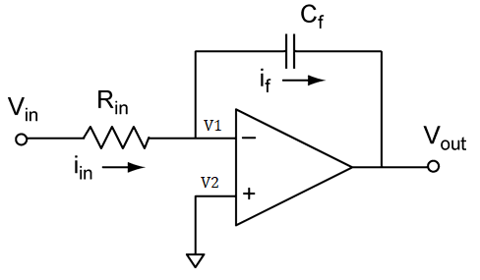

(iv) Integrator:
In an integrator output is proportional to the integral of input signal.
It is an inverting amplifier where we replace feedback resistor with a capacitor of suitable value.
Input signal is applied to the inverting (-) input via resistor R_{in} and the noninverting terminal is connected to the ground.
In an ideal op amp, no current entries to the op amp through both inverting and non-inverting inputs.
$$\frac{V_{in}−V_{1}}{R_{in}}=C_{f}\frac{d}{dt}(V_{1}−V_{out})$$
But,
$$V_{1}=V_{2}=0$$

Slide 18
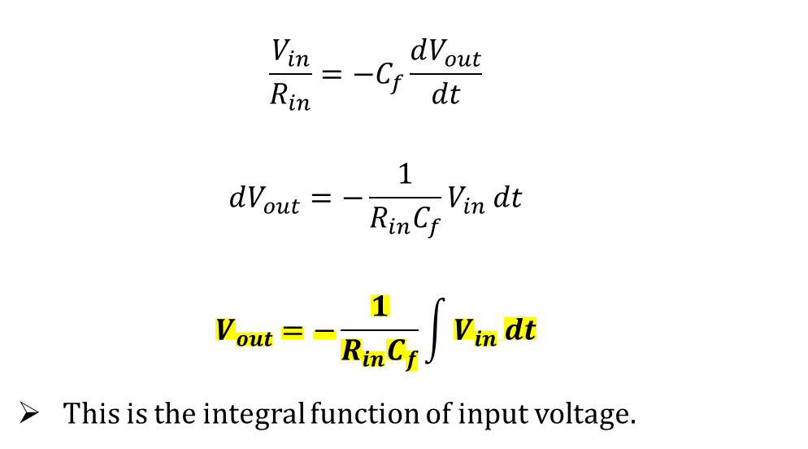
(iv) Integrator:
$$\frac{V_{in}}{R_{in}}=−C_{f}\frac{dV_{out}}{dt}$$
$$dV_{out}=−\frac{1}{R_{in}C_{f}}V_{in} dt$$
$$V_{out}=−\frac{1}{R_{in}C_{f}}\int{V_{in} dt}$$
This is the integral function of input voltage.

Slide 19
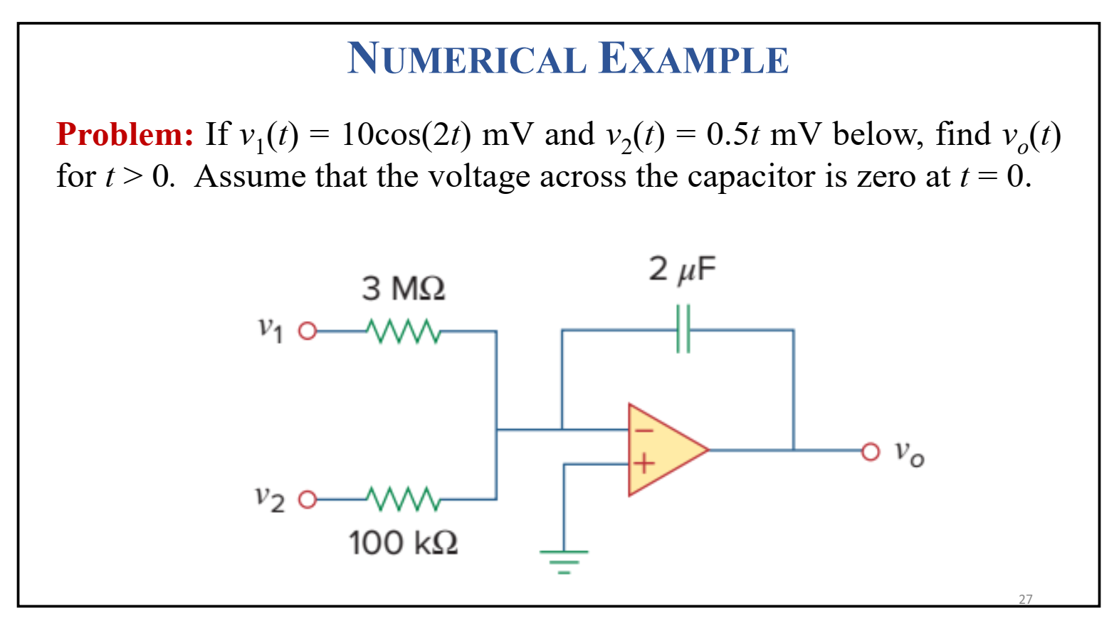
(iv) Integrator:

Slide 20
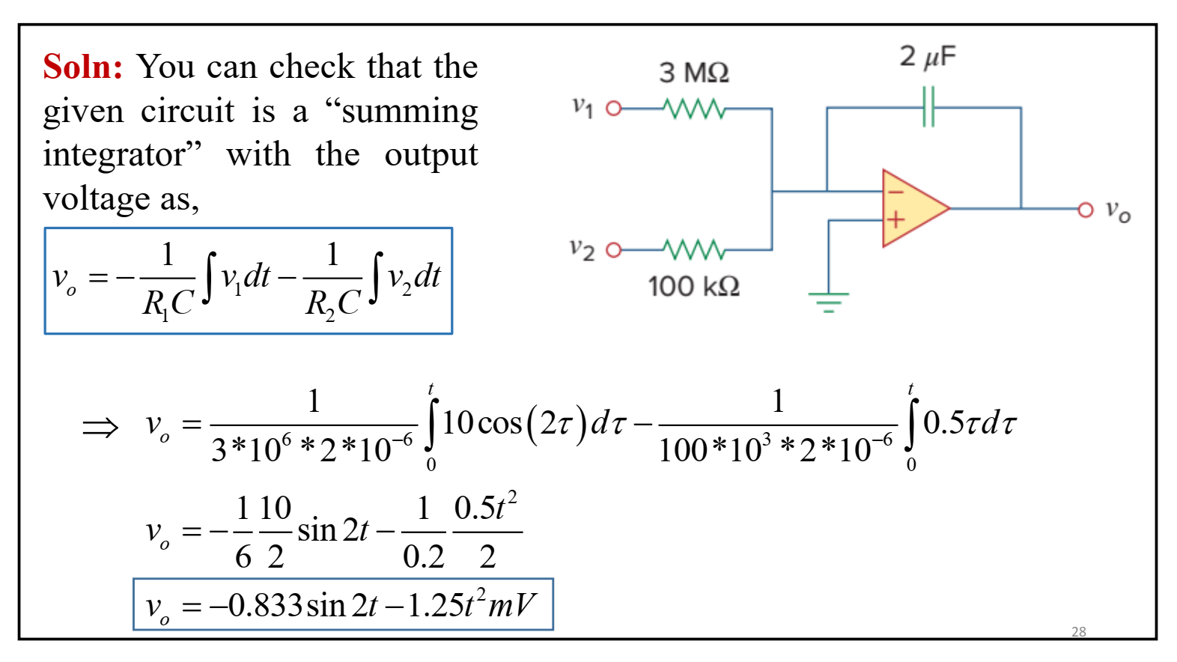
(iv) Integrator:

Slide 21
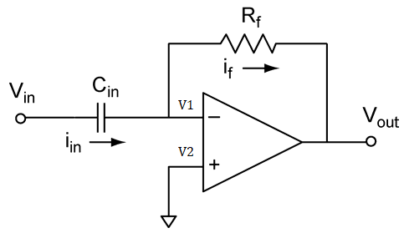
(v) Differentiator:
In a differentiator, output is proportional to the derivative of input signal.
It is an inverting amplifier where we replace feedback resistor with a capacitor of suitable value
Input signal is applied to the inverting (-) input via capacitor C_{in} and the noninverting terminal is connected to the ground.
As the electric potential at non inverting terminal is zero since it is grounded. The electric potential of inverting terminal is also zero, as the op-amp is ideal.
It is also known to us that the current entering through inverting and non-inverting terminal of an ideal op amp is zero.

Slide 22
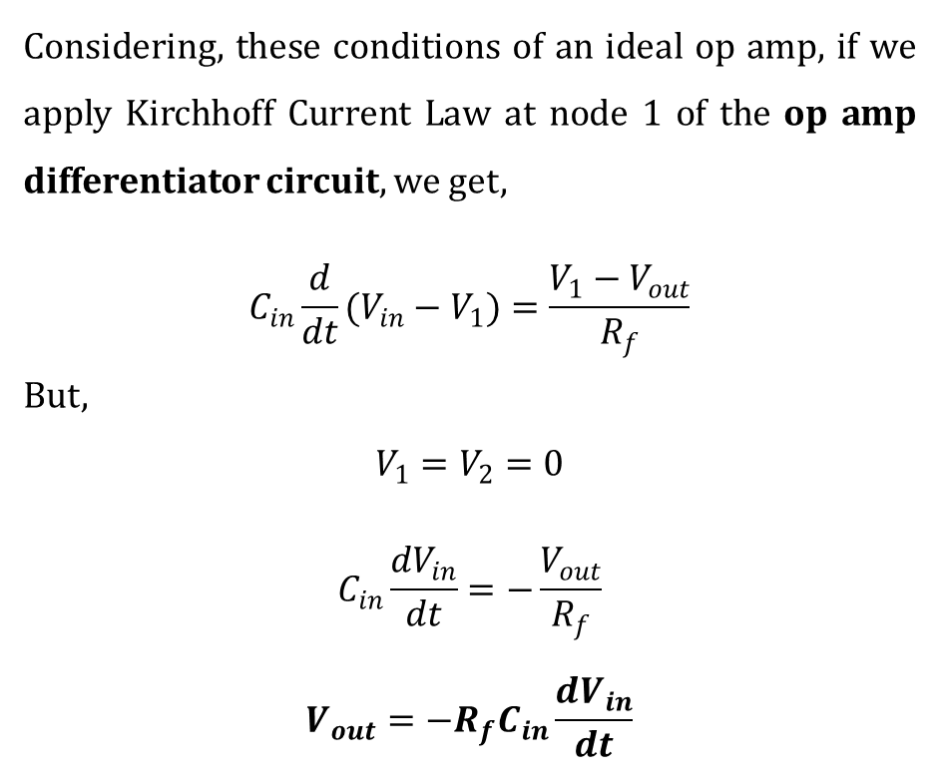
(v) Differentiator:
Considering, these conditions of an ideal op amp, if we apply Kirchhoff Current Law at node 1 of the op amp differentiator circuit, we get,
$$C_{in}\frac{d}{dt}(V_{in}−V_{1})=\frac{V_{1}−V_{out}}{R_{f}}$$
But,
$$V_{1}=V_{2}=0$$
$$C_{in}\frac{dV_{in}}{dt}=−\frac{V_{out}}{R_{f}}$$
$$V_{out}=−{R_{f}C}_{in}\frac{dV_{in}}{dt}$$

Slide 23
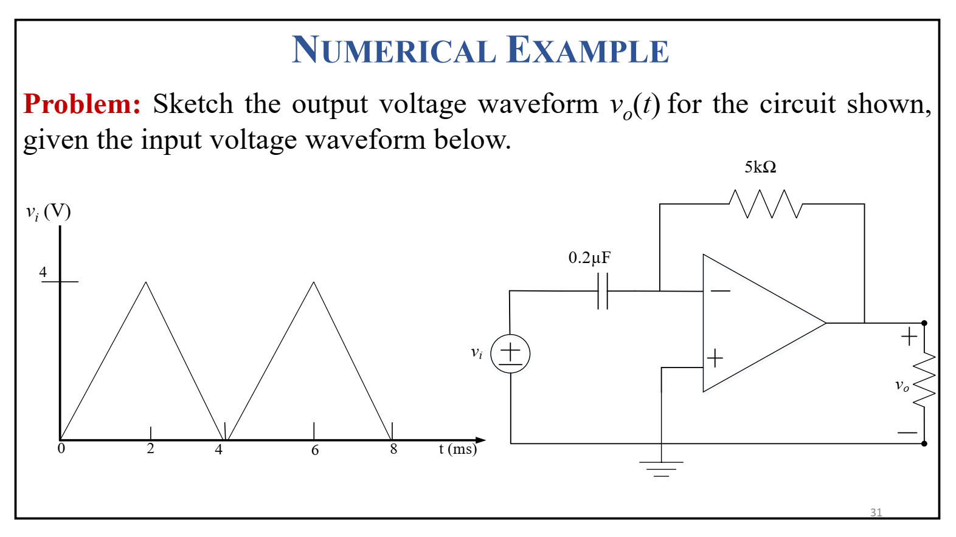
(v) Differentiator:

Slide 24
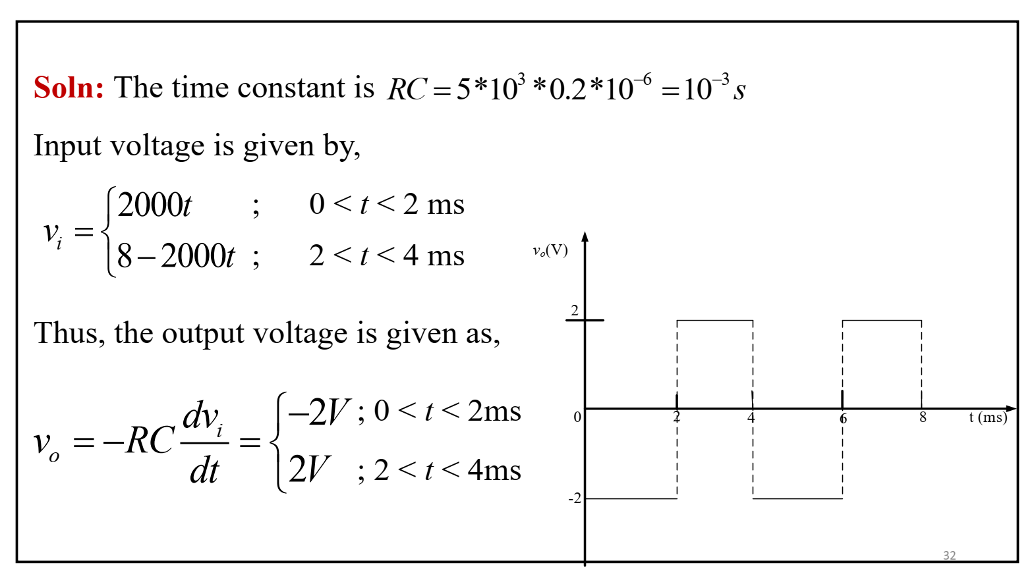
(v) Differentiator:

Slide 25
Parameters of operational amplifier:
Common-mode rejection ratio (CMRR)
Input offset voltage
Input bias current
Input offset current
Input impedance
Output impedance
Slew rate

Slide 26
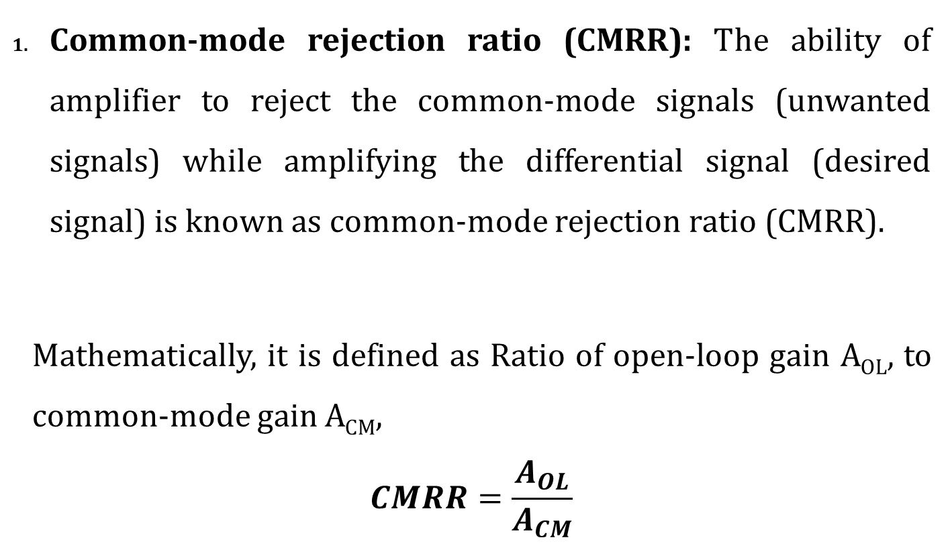
Parameters of operational amplifier:
Common-mode rejection ratio (CMRR): The ability of amplifier to reject the common-mode signals (unwanted signals) while amplifying the differential signal (desired signal) is known as common-mode rejection ratio (CMRR).
Mathematically, it is defined as Ratio of open-loop gain A_{OL}, to common-mode gain A_{CM},
$$CMRR=\frac{A_{OL}}{A_{CM}}$$

Slide 27
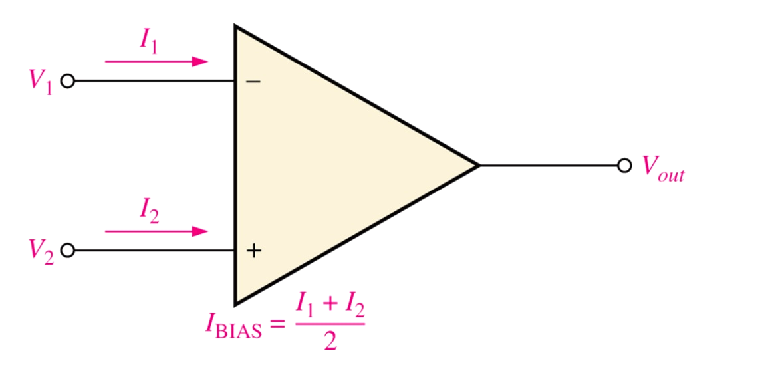
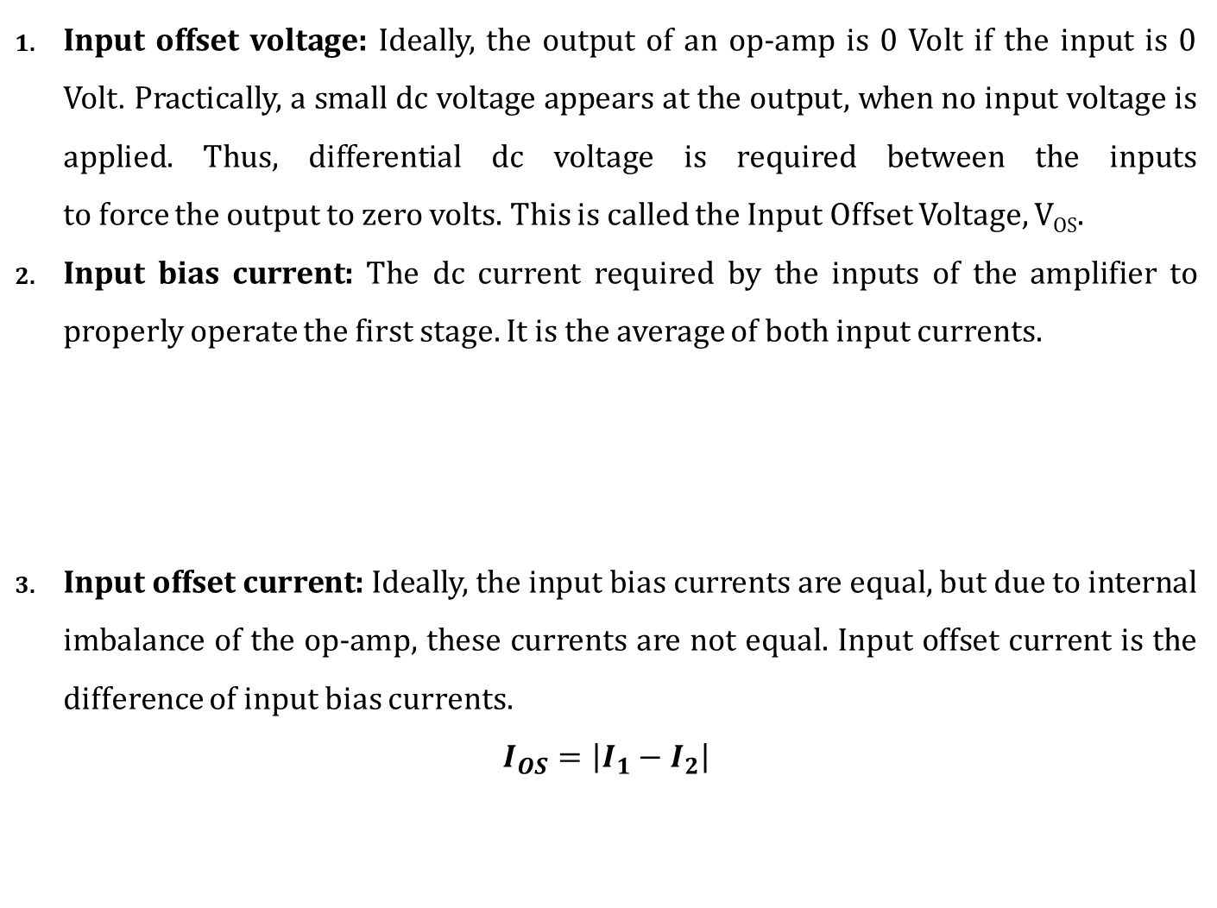
Parameters of operational amplifier:
Input offset voltage: Ideally, the output of an op-amp is 0 Volt if the input is 0 Volt. Practically, a small dc voltage appears at the output, when no input voltage is applied. Thus, differential dc voltage is required between the inputs to force the output to zero volts. This is called the Input Offset Voltage, V_{OS}.
Input bias current: The dc current required by the inputs of the amplifier to properly operate the first stage. It is the average of both input currents.
Input offset current: Ideally, the input bias currents are equal, but due to internal imbalance of the op-amp, these currents are not equal. Input offset current is the difference of input bias currents.
$$I_{OS}=\left|I_{1}−I_{2}\right|$$

Slide 28
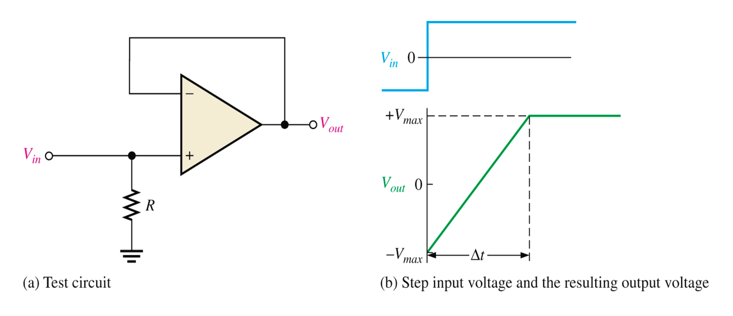
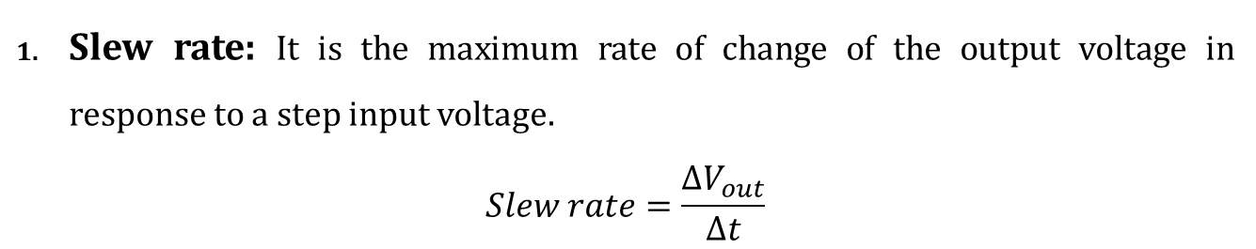
Parameters of operational amplifier:
Slew rate: It is the maximum rate of change of the output voltage in response to a step input voltage.
$$Slew rate=\frac{∆V_{out}}{∆t}$$

Slide 29
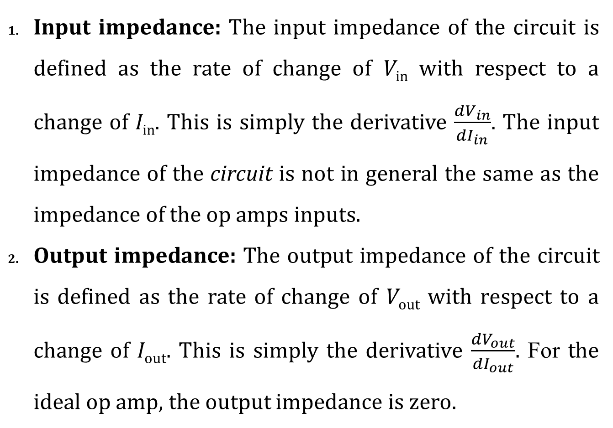
Parameters of operational amplifier:
Input impedance: The input impedance of the circuit is defined as the rate of change of V_{in} with respect to a change of I_{in}. This is simply the derivative $\frac{{dV}_{in}}{{dI}_{in}}$. The input impedance of the circuit is not in general the same as the impedance of the op amps inputs.
Output impedance: The output impedance of the circuit is defined as the rate of change of V_{out} with respect to a change of I_{out}. This is simply the derivative $\frac{{dV}_{out}}{{dI}_{out}}$. For the ideal op amp, the output impedance is zero.

Slide 30
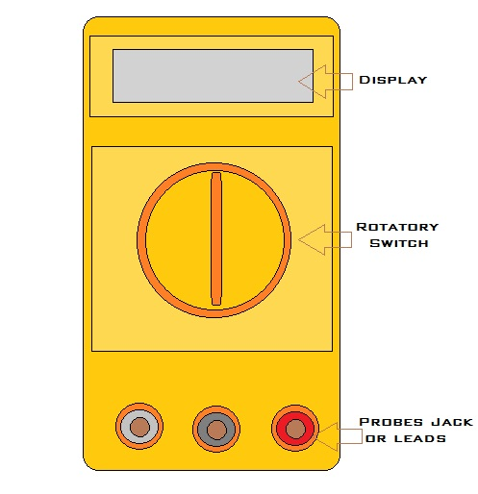
Digital Multi-meter (DMM):
Digital Multi-meter is an electronics Instrument which is used for Several measurement in a single device like voltage, current, continuity and resistance etc. It is also known as voltage ohm meter.
It provides a convenient means of making rapid and accurate measurement of a.c and d.c. voltage, a.c and d.c. current and resistance in wide range.
The Digital multi-meter has two term one is digital that means indicate that the device has a digital or LCD output and second term is multi-meter that means that a single device can be used for multipurpose measurements.

Slide 31
Digital Multi-meter (DMM):
Part of Digital multi-meter
Display: It has illuminated Display Screen for better visualization and it has five-digit resolution display screen.
Selection Knob: Multi-meter is used for several measurements Like Voltage, Current and Resistance. The Selection Knob allows the user to select the different measurements.
Port: It has three port. One is mAVΩ Port, this port (Positive probe or Red probe) Can used for current, voltage and resistance measurement and second is common Port also called black probe. Third Port is used for measuring current greater than 10A. It is also called current port.

Slide 32
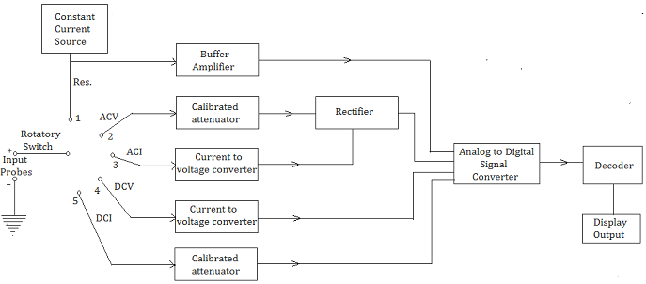
Digital Multi-meter (DMM):
Block Diagram of Digital multi-meter:
Two input probes, one is positive probe and second is a common negative probe.
The Rotatory switch is rotated and connected to the point of circuit block by which is selected the input measurements. it can be voltage, current and resistance.

Slide 33
Digital Multi-meter (DMM):
Block Diagram of Digital multi-meter:
The Rectifier is used for converting ac input to dc before applying to Analogue to Digital converter it is also filter ripple of the ac signals.
All Block circuit operation is depending on applications. A/D Converter (Analog to Digital Converter) is a main function of digital multi-meter circuit.

Slide 34
Digital Multi-meter (DMM):
Block Diagram of Digital multi-meter:
It converts analog signal to digital signal which is operated for all measurements.
The accuracy of the multi-meter depends on the accuracy of A/D Conversion and built-in precision voltage references.

Slide 35
Digital Multi-meter (DMM):
Block Diagram of Digital multi-meter:
A/D converter pass the signal into digital counter decoder and decoder converts the signal into digit and provide output in digit form on LCD display.
Low-cost multi-meter uses single chip digit A/D converter and high precision digital multi-meters uses microprocessor controlled discrete A/D converters.

Slide 36
Sensors:
A sensor is defined as a device or a module that helps to detect any changes in physical quantity like pressure, force or electrical quantity like current or any other form of energy.
Classification of Sensors
1. Active and Passive Sensors
2. Analog and Digital Sensors
1. Active Sensors & Passive Sensors
Active sensors produces output signal with help of external excitation supply.
Passive sensors produces output signal without the help of external excitation supply. They do not need any extra stimulus or voltage.
Example: Thermocouple, which generates a voltage value corresponding to the heat, applied. It does not require any external power supply.

Slide 37
Sensors:
Different types of sensors:
Infrared Sensor (IR Sensor): An infrared sensor is used for emitting and detecting IR radiation. By this principle, IR sensor can be used as Obstacle detector.
Temperature & Thermocouple Sensors: Temperature sensor sense the temperature and measures the changes in the temperature.
Proximity Sensor: Proximity sensor is a type of non-contact sensor used for object detection. It does not have any physical contact with the object. The object whose distance is to be measured is known as target. An IR light or electromagnetic radiation is used in a proximity sensor.

Slide 38
Sensors:
Different types of sensors:
Ultrasonic sensor: Ultrasonic sensors are used to measure distance or travel time using ultrasonic waves. A source will be used to emit ultrasonic wave. After wave hits the target, the waves are reflected and the detector collects the signal.
Light Sensor: In light sensor, digital LED or opto-detector used to produce a Digital Signal to measure the speed of rotating body.
Colour Sensor: A color sensor detects the color of the material. This sensor usually detects color in RBG scale. This sensor can categorize the color as red, blue or green.

Slide 39
Sensors:
Different types of sensors:
Touch Sensor: A touch sensor used in detecting and recording physical touch. Also known as tactile sensors.
Metal detector: A metal detector detects the presence of metal nearby. Metal detectors are useful for finding metal inclusions hidden within objects, or metal objects buried underground.
Smoke, Fog, Gas, Ethanol & Alcohol Sensor: A gas sensor detects the presence or concentration of gases in the atmosphere.
Soil moisture sensor: Soil moisture sensors measure the volumetric water content in soil.

Slide 40
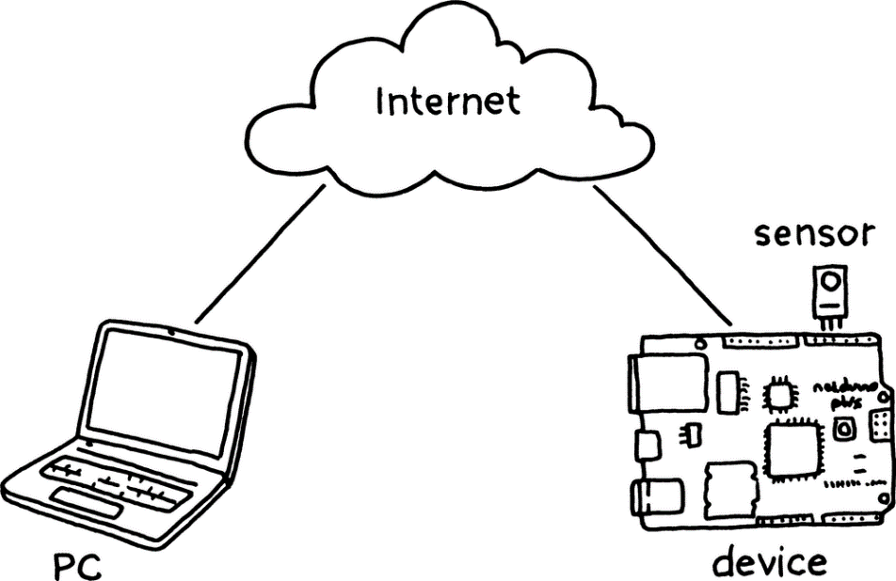
Internet of Things (IoT):
Internet of Things (IoT) is a network of embedded systems (devices) with internet connectivity, which allows them to connect to and interact with other embedded devices, services (machines or appliances) and people on a large scale.
It enables the things to be connected or controlled anytime, anyplace with anyone or anything using any path or network and any service.

Slide 41
Internet of Things (IoT):
The main aim of Internet of Things (IoT) is to make different tasks much easier for user control and monitoring.
It refers to the network of physical objects that are embedded with electronics, sensors, actuators, software and communication connectivity, in which the whole arrangement enables the exchanging of data, remote sensing and control of various objects or things.

Slide 42
Internet of Things (IoT):
The applications of IoT can be divided into three domains. They are Individual, Industry and Infrastructure.
Home Applications | Consumer electronics | Transport system
1. Security systems 2. Energy monitoring systems 3. Water management 4. Home entertainment systems 5. Personal health monitoring systems | 1. Wearable devices 2. Fitness monitoring 3. Kids, elders and pets monitoring | 1. Driverless or autonomous driving 2. Traffic information 3. Vehicle diagnostics like engine, oil, brake etc. 4. Location based services like GPS

Slide 43
Internet of Things (IoT):
2. Industrial applications:
Agriculture include irrigation, production, cattle, livestock etc.
In factories, the concept of automation, robotics, machine and process control etc.
Construction and civil works include smart buildings and offices, heating, air conditioning, ventilation, HVAC, lighting, energy monitoring etc.
Communication
Manufacturing
In health sector, health monitoring, clinical and research labs, diagnostics, treatment and insurance.
Smart shops include vending machines, ATMs, electronic point of sale, smart retail units, hospitality etc.
Smart environment include surveillance and monitoring of air and water for pollution.

Slide 44
Internet of Things (IoT):
3. Infrastructure applications:
Smart education
Security, defence and disaster management
Public safety includes ambulance, police, fire and surveillance.
Public transportation includes trains, buses, planes, cargo, smart vehicles, etc.
Highways include lighting, parking, tolls, meters etc.

